Slide 1
MUNA Matrimonial Site
Admin Guideline

Slide 2
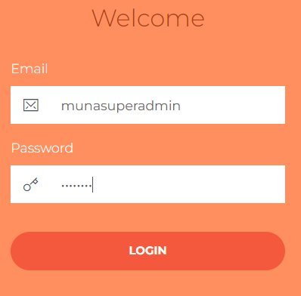
Admin URL
https://munamatrimonial.com/adminmuna24434/#/admin
Pass: muna1234

Slide 3
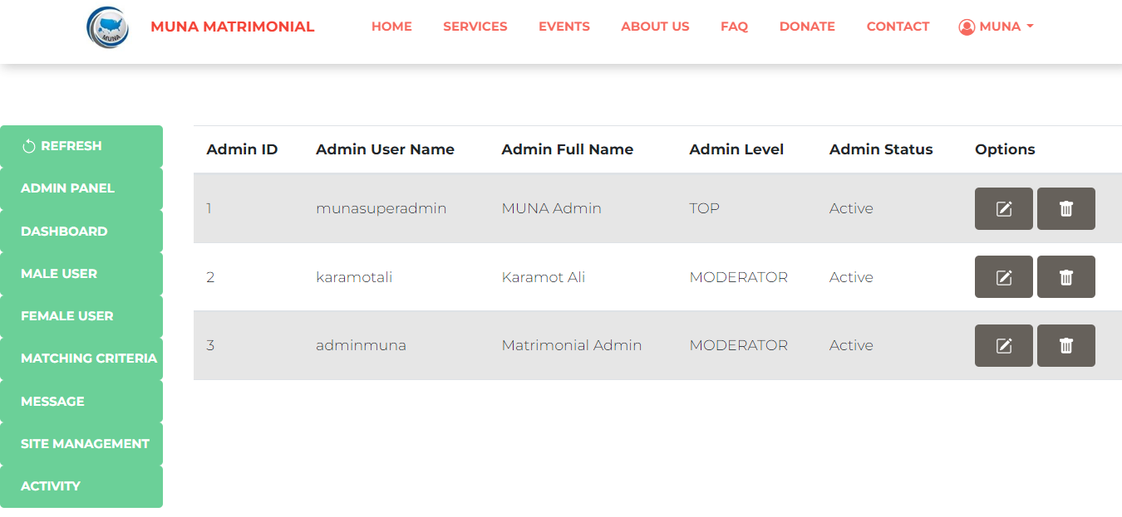
Admin Home

Slide 4
Admin Panel

Slide 5
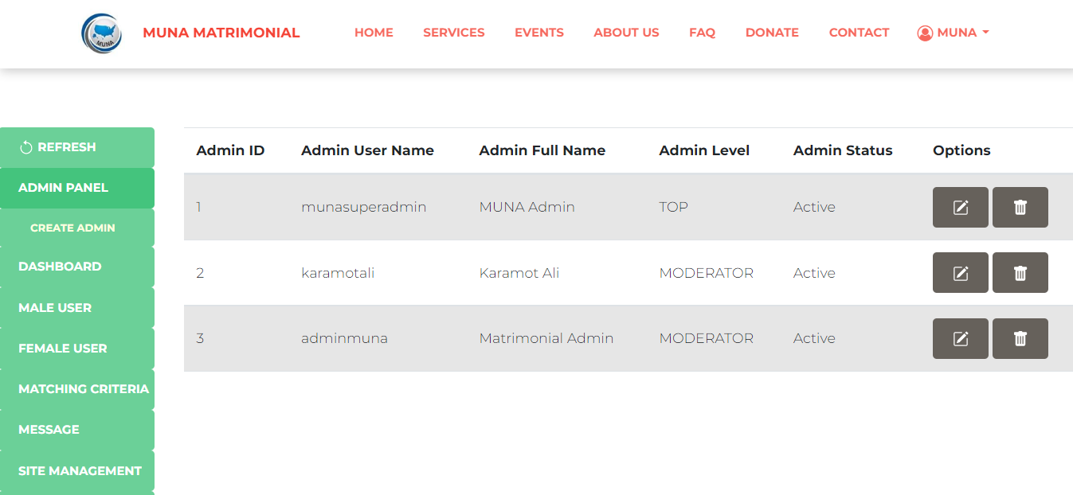
Admin Panel

Slide 6
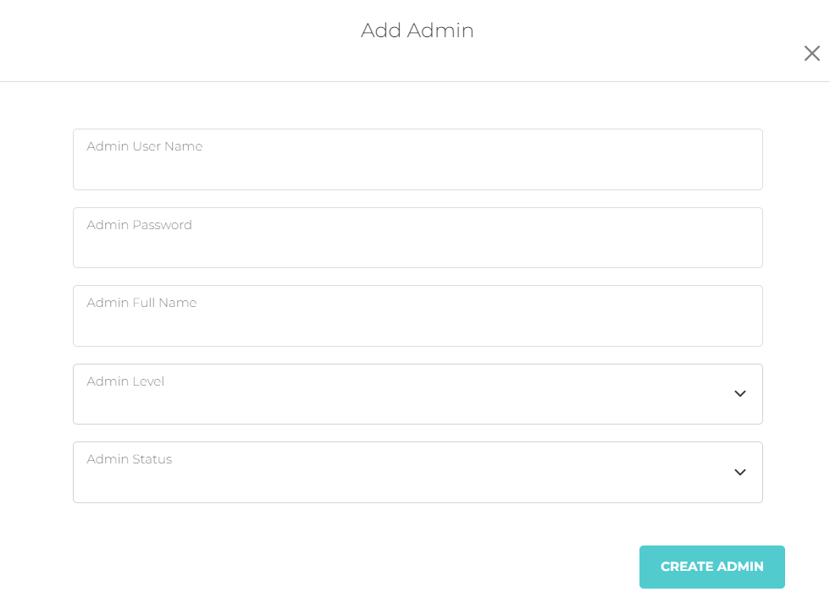
Create Admin

Slide 7
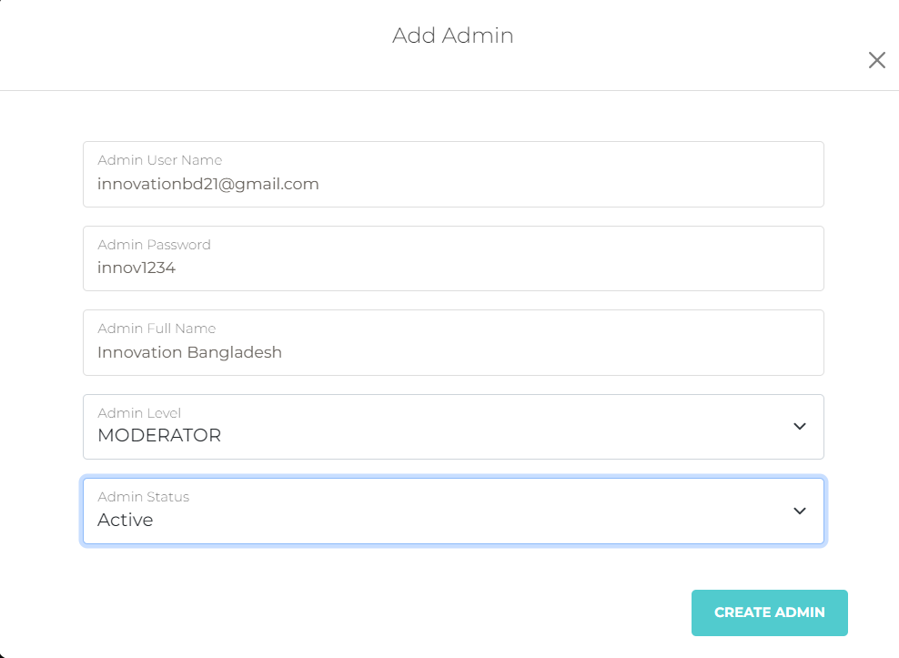
Create Admin

Slide 8
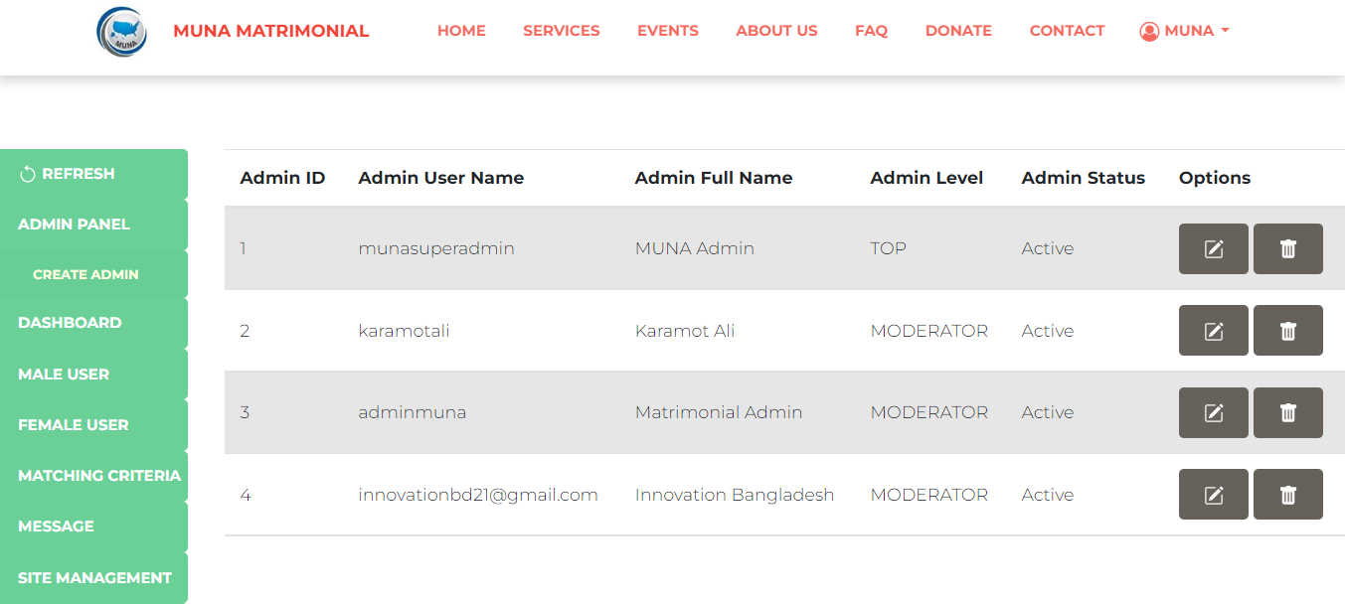
Edit Admin

Slide 9
Delete Admin

Slide 10
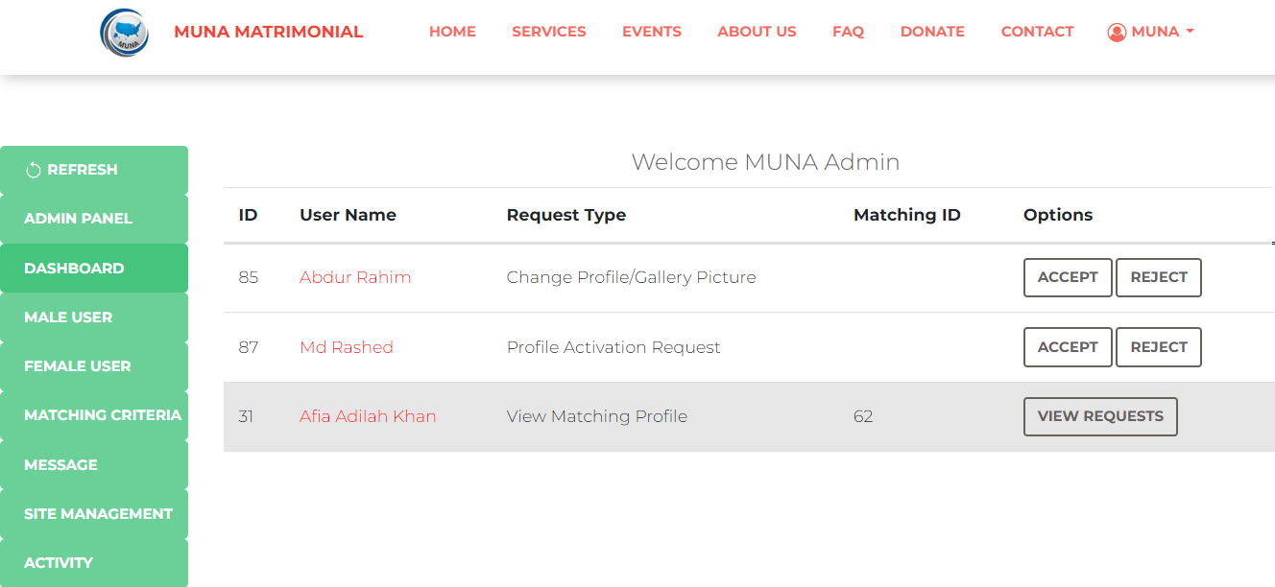
Dashboard

Slide 11
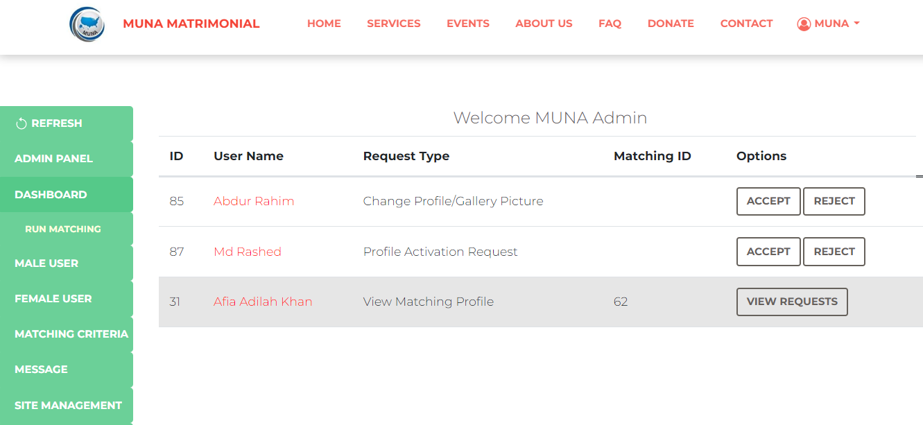
Run Matching Admin should run Matching everyday

Slide 12
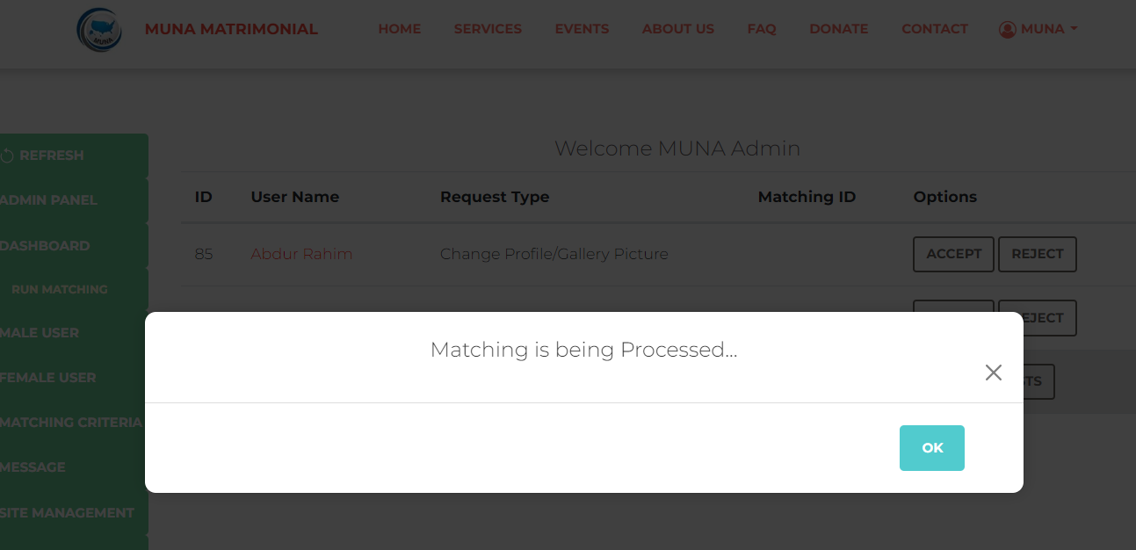
Run Matching Admin should run Matching everyday

Slide 13
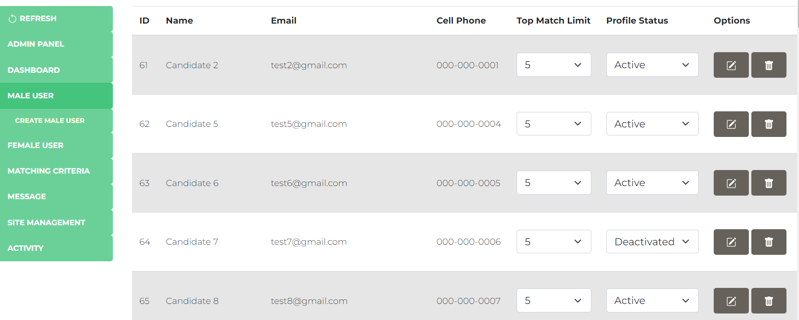
Male Users

Slide 14
Create Male Users Admin can create user arbitrarily for testing

Slide 15
Edit/Delete Male Users

Slide 16
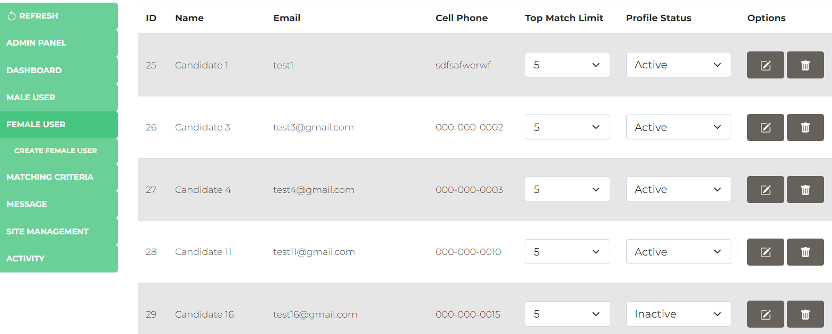
Similar Functions for Female Users also

Slide 17
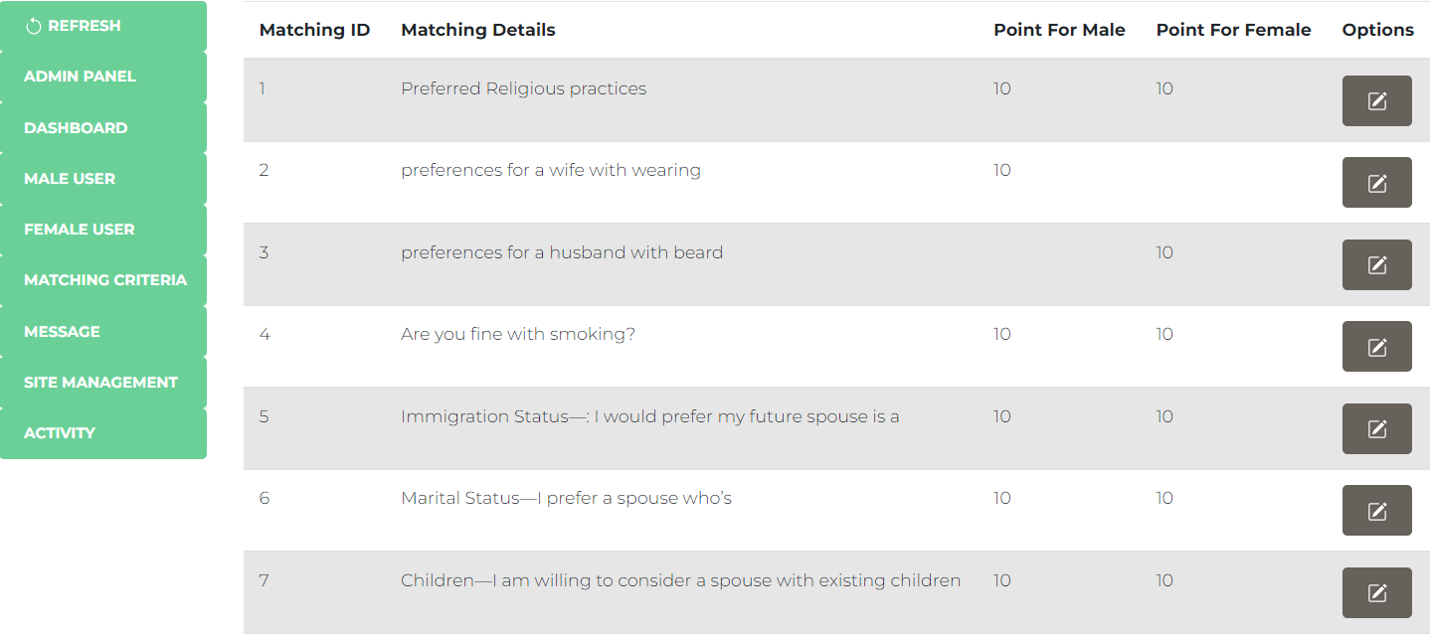
Matching Criteria These criteria are used for matching

Slide 18
Matching Criteria Admin can edit weight (point) for each criterion

Slide 19
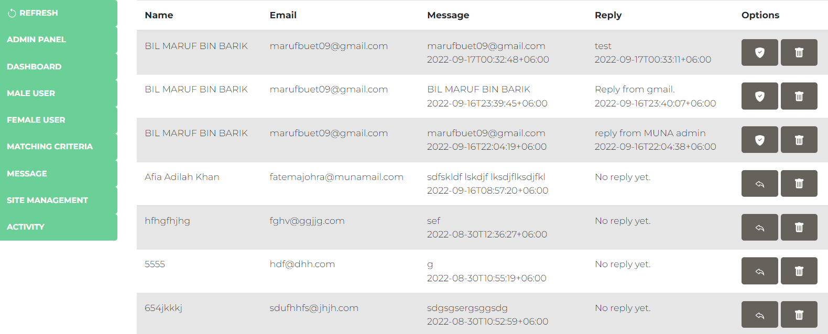
Messaage Admin can view, reply & delete the messages that users sent
View Message
Reply Message
Delete Message

Slide 20
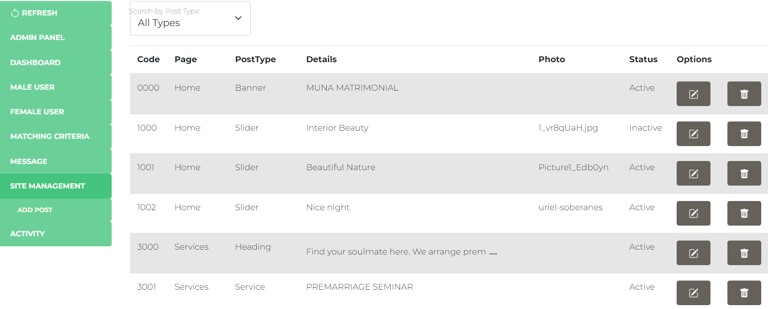
Site Management To edit home page contents

Slide 21
Add Post

Slide 22
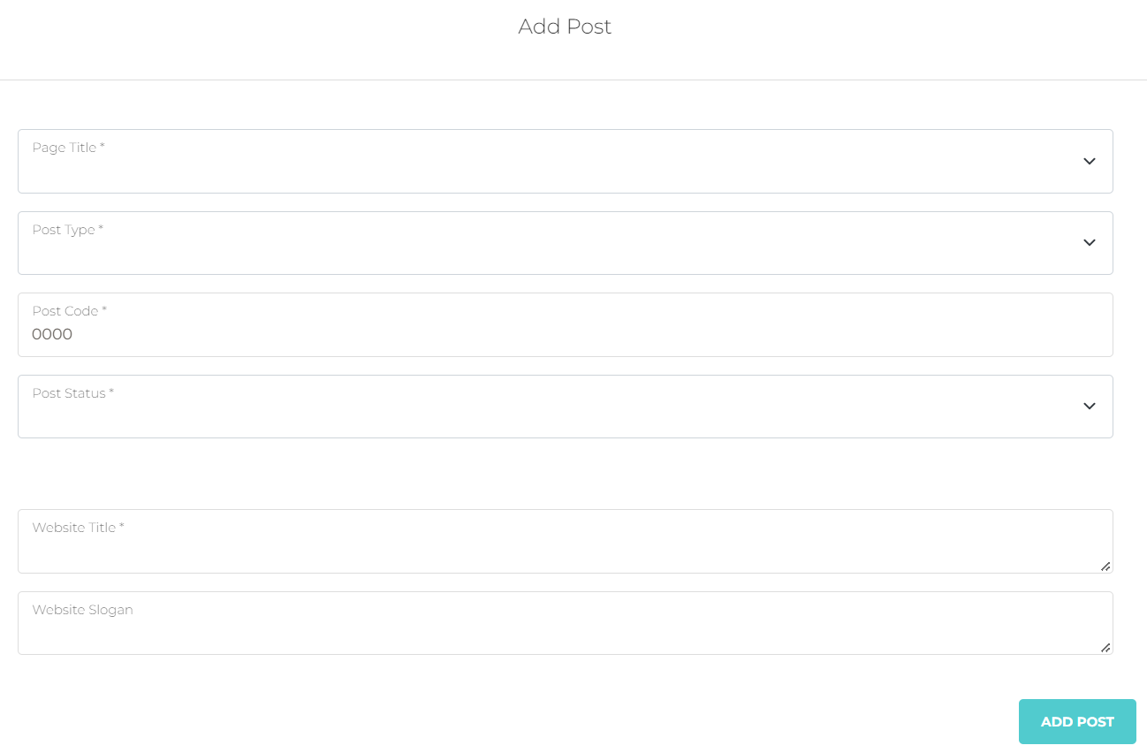
Add Post

Slide 23
Add Post

Slide 24
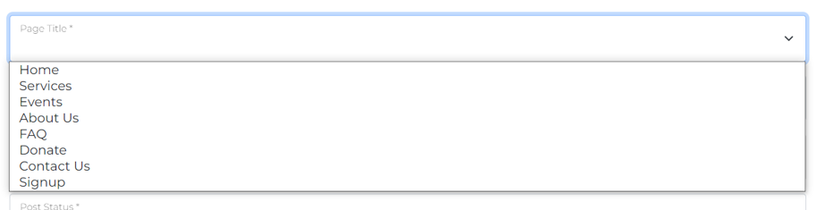
Add Post
There are several pages, select a page to add content to that page

Slide 25
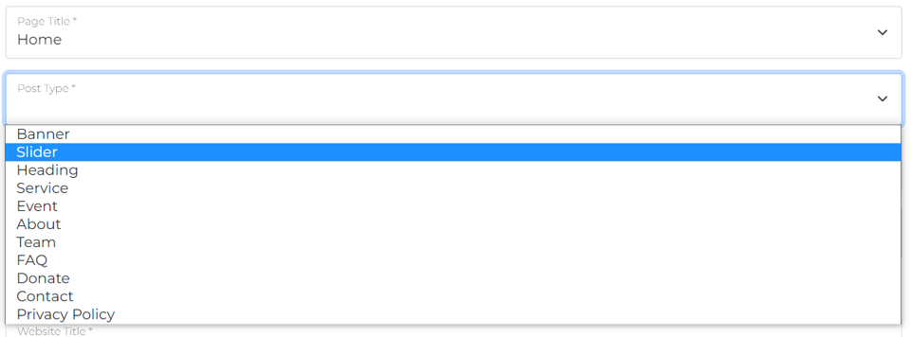
Add Post
There are several types of posts, select a post type to add content

Slide 26
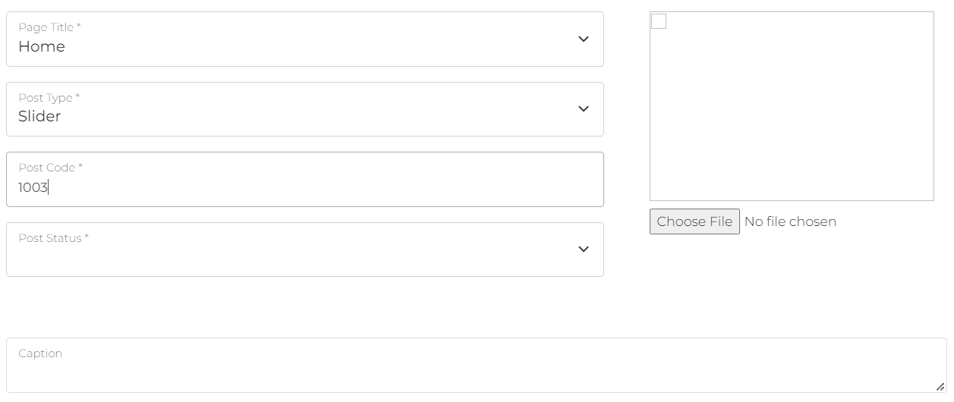
Add Post
No need to edit Post Code. It will generate automatically.

Slide 27
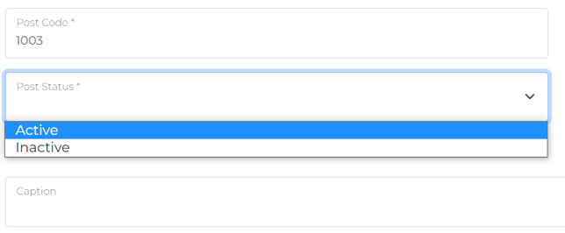
Add Post
Select Post Status as “Active”. If “Inactive” is selected, that content will not be visible

Slide 28
Add Post
Browse photo if required. Here, we select post type “Slider”, so we must upload photo that will be shown as slider.

Slide 29
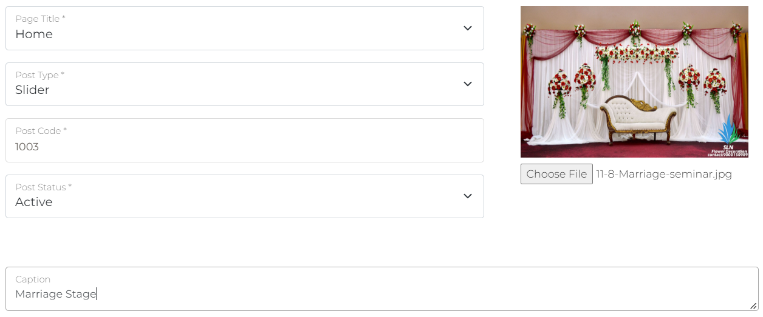
Add Post You may add Necessary Details for the Post (Here, for Post Type “Slider”, detail is only “Caption”)
You may add Necessary Details for the Post (Here, for Post Type “Slider”, detail is only “Caption”)

Slide 30
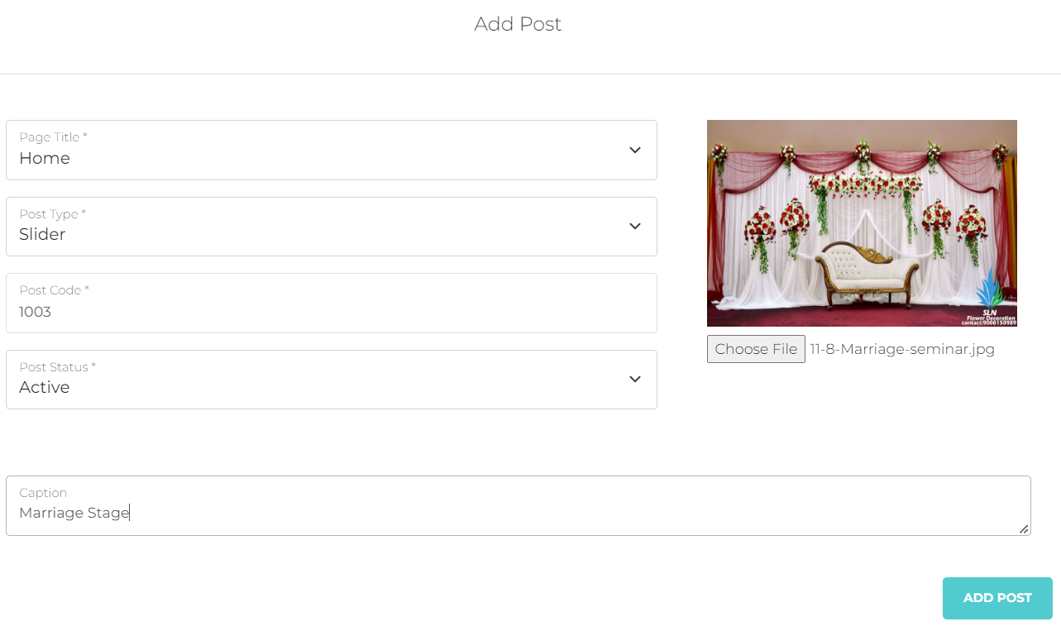
Add Post You may add Necessary Details for the Post (Here, for Post Type “Slider”, detail is only “Caption”)

Slide 31
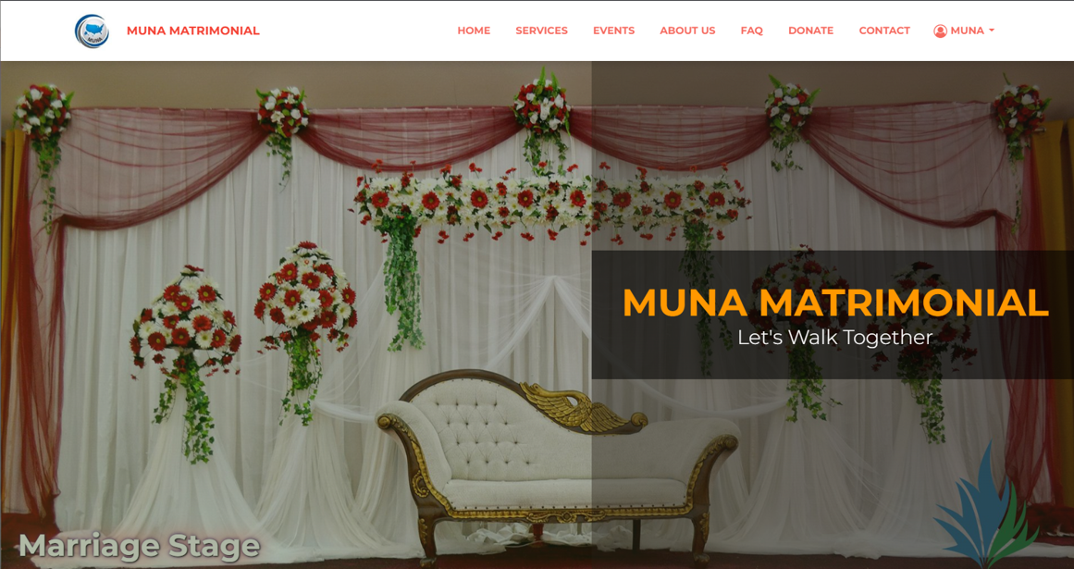
Slider has been Added!

Slide 32
Edit Post Any post can be edited in a similar way

Slide 33
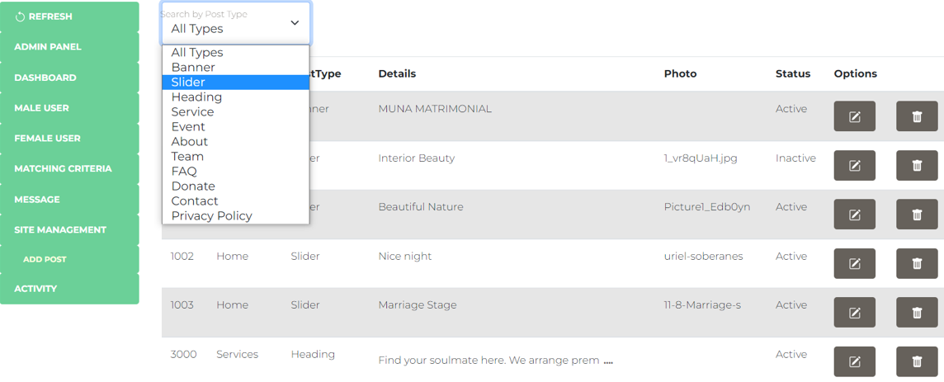
You may Filter by Post Type to view only the Specific Post Type

Slide 34
Site Management
You may edit site contents by the following sets of
Page Title
Post Type
And Description

Slide 35
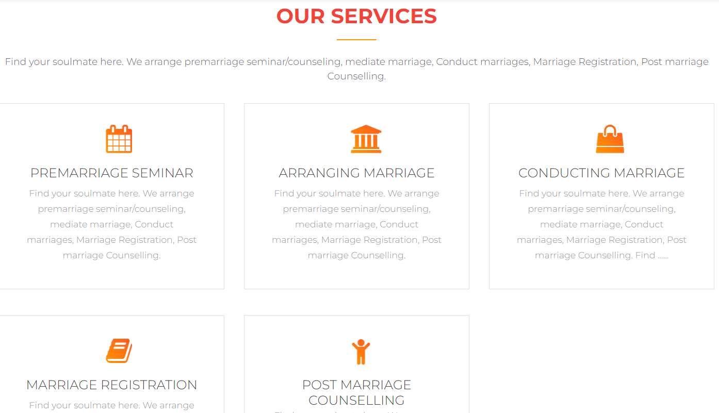
Page Title = Services
Post Type = Heading
Description: Heading

Slide 36
Service Icon
Service Name
Page Title = Services
Post Type = Service
Description:
Service Name
Service Icon
Service Details
Service Details

Slide 37

Page Title = Events
Post Type = Heading
Description: Heading

Slide 38
Page Title = Events
Post Type = Event
Description:
Caption
Date & Time
Event Venue
Event Details

Slide 39

Caption
Date and Time
Event Venue
Event Details

Slide 40
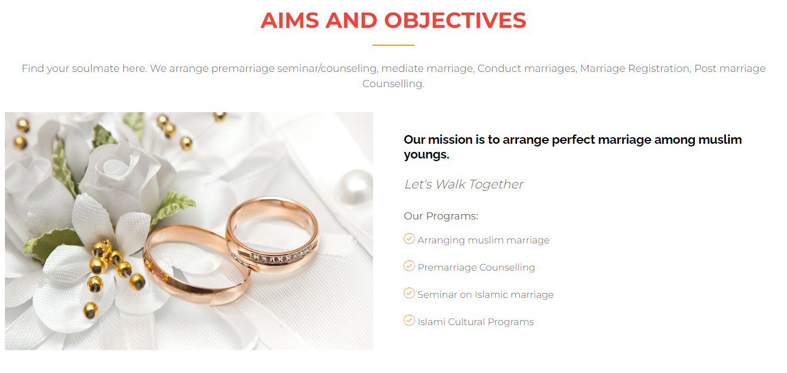
Page Title = About Us
Post Type = Heading
Description: Heading

Slide 41
Page Title = About Us
Post Type = About
Description:
Mission
Vision
Program Heading
Program List
Mission
Vision
Program Heading
Program List
Separated by newline (‘Enter)

Slide 42
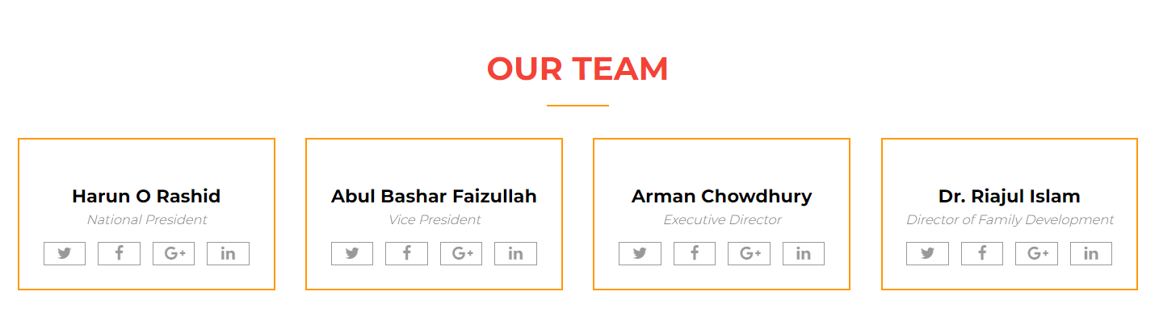
TEAM
Page Title = About Us
Post Type = Team
Description:
Name,
Designation,
Links
Name
Designation
Links
Separated by newline (‘Enter’)

Slide 43
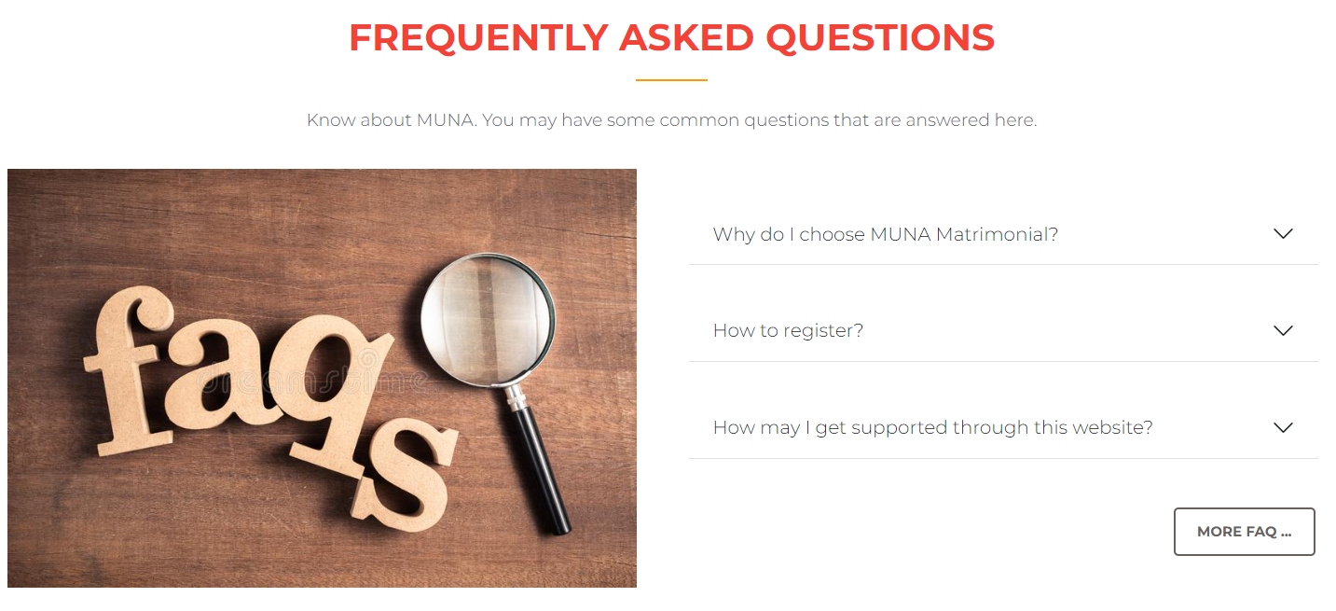
Page Title = FAQ
Post Type = Heading
Description: Heading

Slide 44
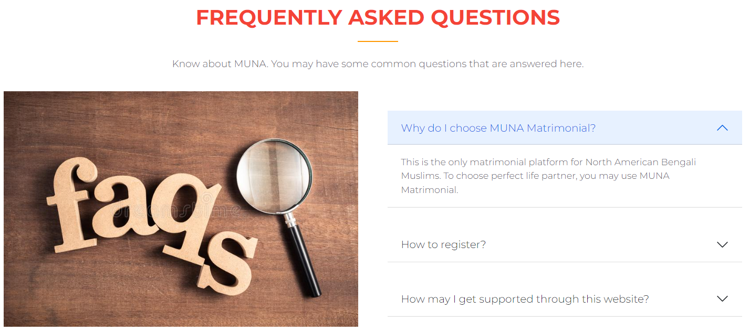
Page Title = FAQ
Post Type = FAQ
Description:
Question
Answer
Question
Answer

Slide 45
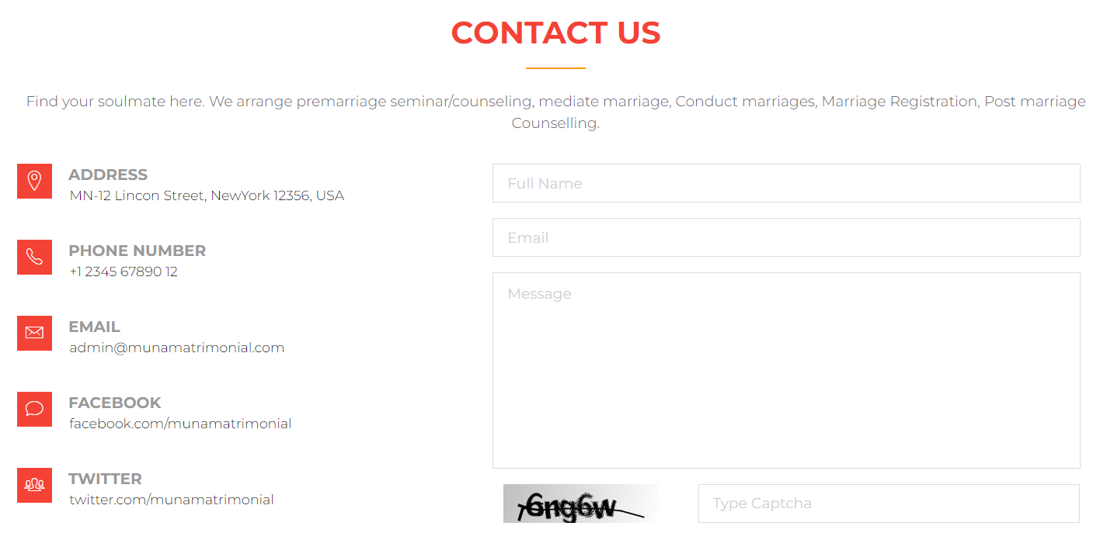
Page Title = Contact Us
Post Type = Heading
Description: Heading

Slide 46
Address
Phone
Page Title = Contact Us
Post Type = Contact
Description:
Address
Phone
Email
Social
Map
Email
Social
Separated by newline (‘Enter’)

Slide 47
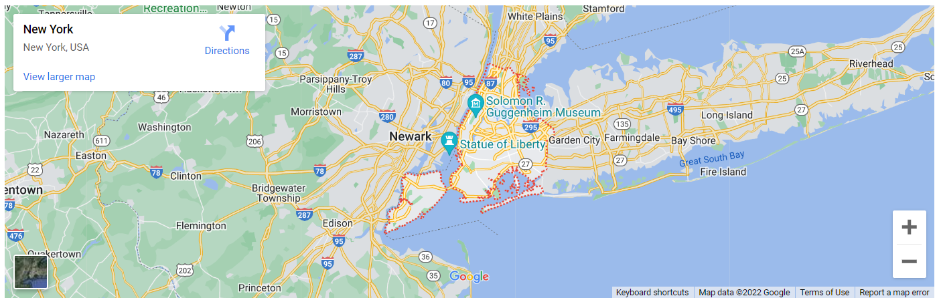
MAP
Page Title = Contact Us
Post Type = Contact
Description:
Address
Phone
Email
Social
Map

Slide 48
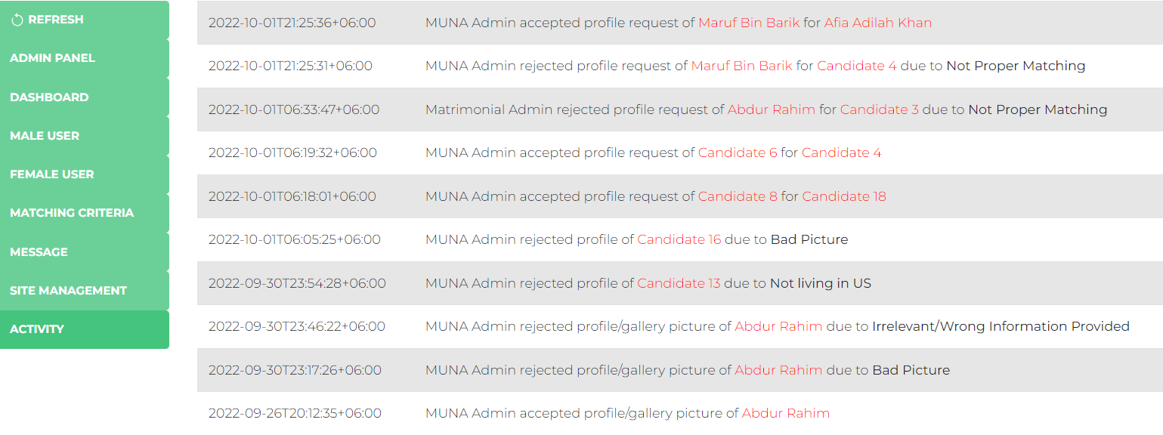
Activity To see admin activity log for various request handling

Slide 49
THANK YOU
For any query, please call +880 1748 717374 (Whatsapp)

